Slide 1
Storyboarding
Imran Mahmud

Slide 2
Definition
Storyboards are visual organizers, typically a series of illustrations displayed in sequence for the purpose of pre-visualizing a video, web based training, or interactive media sequence

Slide 3
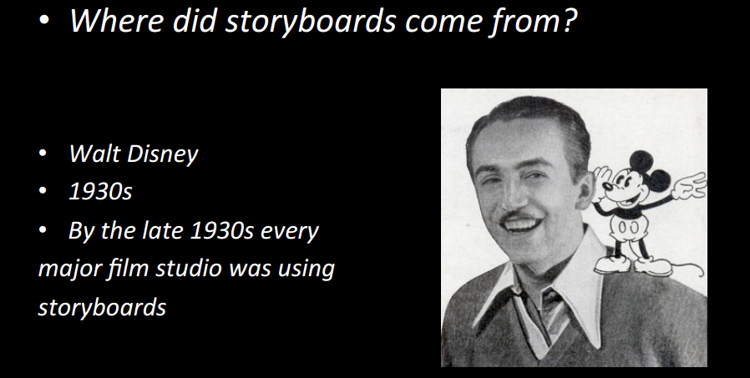

Slide 4
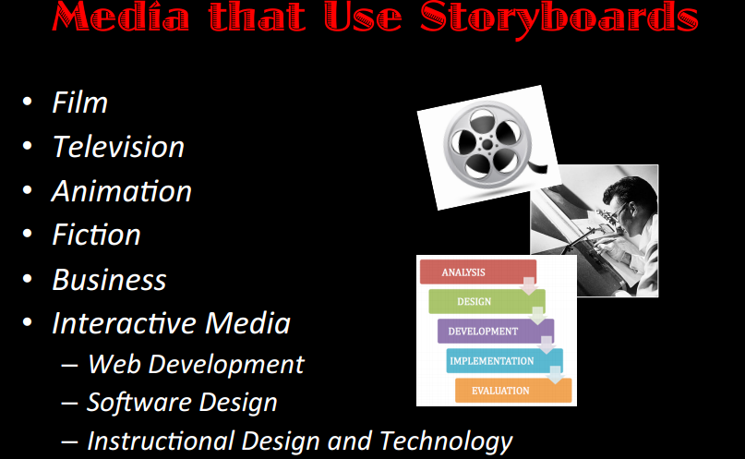

Slide 5
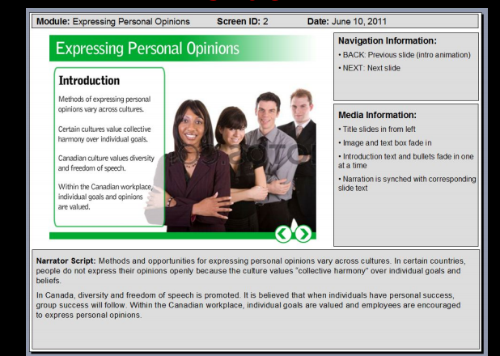

Slide 6
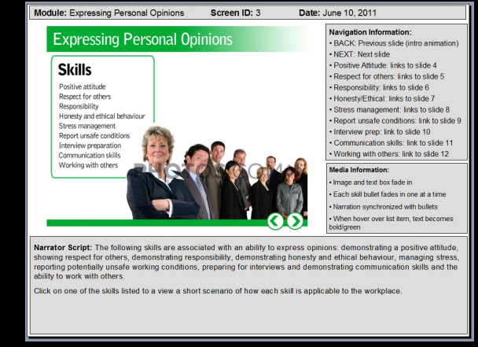

Slide 7
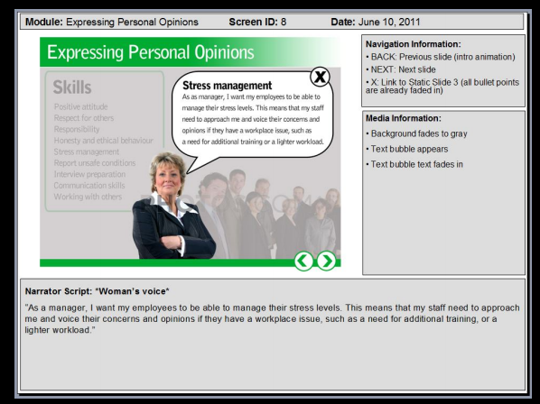

Slide 8
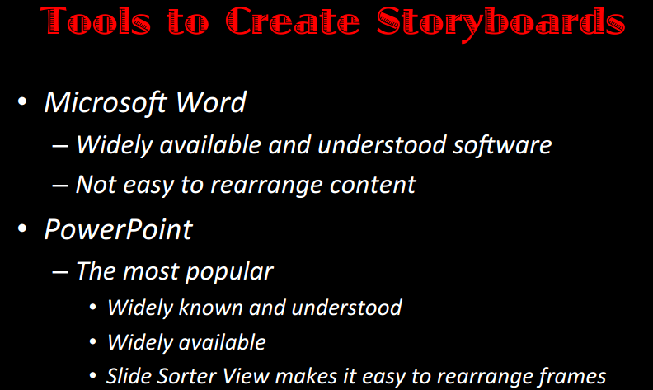

Slide 9


Food order system
Food Service
Order

Slide 10
Table no
Food Service
Select Table no
Table 1
Table 2
OK

Slide 11
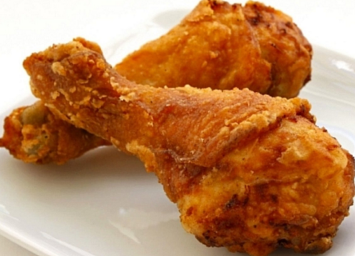
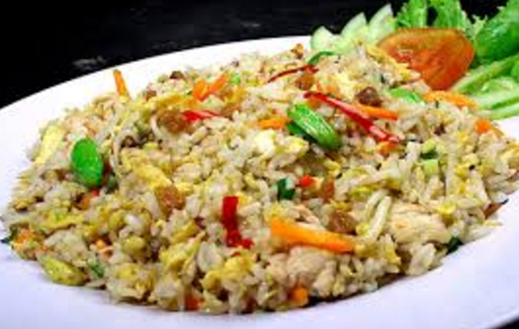
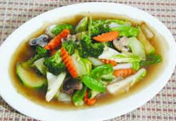
2nd Page
150 tk
120 tk
80 tk

Slide 12
Order PAGE
Insert Quantity
2
Submit

Slide 13
Next
Table 1
2 set chicken fry
Price: 300 tk
Order More
Check out

Slide 14
Thank you for order. Food will be served in 10 minutes.

